Slide 1
Lecture 9.5 Internal Labour markets

Slide 2
Internal Labour Markets
Firms use internal labour markets to fill vacancies within the firm. Why use internal labour markets?
Easier than external hiring
Information asymmetries are largely resolved
Provide greater incentive for individuals to invest in firm specific human capital
Motivation – long term relationships can encourage individuals to work hard
Learning benefits for the employer and the employee.

Slide 3
Internal Labour Markets
In a long-term relationship, employees look beyond their immediate payoff.
Suppose that a firm does not pay the market wage initially, but that compensation increases over time. What is important is the net present value (NPV) of the earnings profile: the career earnings path.
There are at least three ways that firms can retain workers and encourage effort:
Efficiency wages: pay above market rates
Upwards sloping earnings profiles: offer pay rises for seniority to encourage retention
Promotions: offer promotions to productive workers

Slide 4
Internal Labour Markets – Efficiency wages
To encourage effort and loyalty, firms may offer efficiency wages: wages above the market rate. Rationale:
suppose effort is costly to monitor
to induce effort, offer high wages
combine with light or probabilistic monitoring
and threaten termination for poor effort
with above-market wages, workers are motivated to work hard to avoid termination

Slide 5
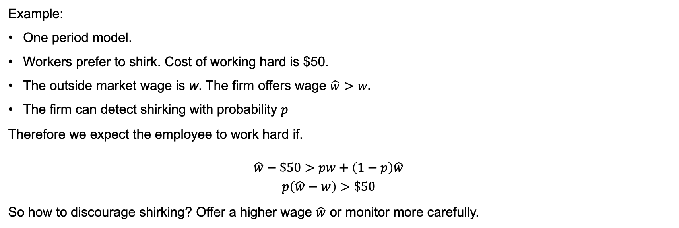
Internal Labour Markets – Efficiency wages
Example:
One period model.
Workers prefer to shirk. Cost of working hard is $50.
The outside market wage is w. The firm offers wage $\hat{w}>w.$
The firm can detect shirking with probability $p$
Therefore we expect the employee to work hard if.
$$\hat{w}−\$50>pw+\left(1−p\right)\hat{w}$$
$$p\left(\hat{w}−w\right)>\$50$$
So how to discourage shirking? Offer a higher wage $\hat{w}$ or monitor more carefully.

Slide 6
Internal Labour Markets – Efficiency wages
Benefits of efficiency wages:
Attracting better employees
Building better employee commitment. Workers are less likely to quit. Firms may be more likely to offer training.
Create a greater perception of equity. Employees may feel that an employer is ‘sharing’ the surplus fairly.
Greater productivity.

Slide 7
Internal Labour Markets – Efficiency wages
Is there any evidence that firms pay efficiency wage?
The Ford Motor company is often cited as the classic example.
With introduction of assembly lines, large workforce of relatively unskilled labour that exhibited high rates of turnover (370%); high absenteeism. In 1913, wages rates were about $2.50 per day.
From January 1914 wage rates increased to $5.00 per day for workers who had been employed for 6 months or more.
The effect?
Quit rate fell by 87%, discharges fell by 90%, and absenteeism fell by 75%.
There were other factors at work, but nonetheless is a lesson in the incentive provided by higher wages.

Slide 8
Internal Labour Markets – Job Seniority
Another common mechanism is to reward seniority.
In the initial stages of the employment relationship workers are paid below their MRP (underpaid)
They are paid more than their MRP (overpaid) in later years.
Compensation increases more rapidly than productivity.

Slide 9
Annual compensation and MRP ($)
Compensation
MRP
Note that for the compensation package to be competitive, it must be the case that the NPV of the blue area must equal the NPV of the yellow area.
C₂
C₁
MRP = (MPP)x(MR) = incremental revenue
0
Tenure at firm
0
r*

Slide 10
Internal Labour Markets – Job Seniority
Rationale for workers:
Workers accept the job because they anticipate future rewards
Workers are motivated to work hard because of future rewards
Benefits to the firm:
Selection: high future wages attracts workers who are likely to stay
Incentives: workers exert effort, lured by later rewards (possibly reducing monitoring costs)
Incentives: workers are motivated to make firm-specific investments
Potential challenge
Approach depends crucially on trust. The reputation of the firm will be critical. Will pay really increase with seniority?

Slide 11
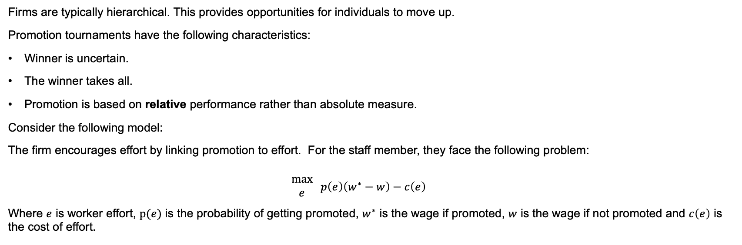
Internal Labour Markets – Promotions
Firms are typically hierarchical. This provides opportunities for individuals to move up.
Promotion tournaments have the following characteristics:
Winner is uncertain.
The winner takes all.
Promotion is based on relative performance rather than absolute measure.
Consider the following model:
The firm encourages effort by linking promotion to effort. For the staff member, they face the following problem:
$$\begin{matrix}\text{m}\text{ax} \\ e\end{matrix} p\left(e\right)\left(w^{∗}−w\right)−c\left(e\right)$$
Where $e$ is worker effort, $p(e)$ is the probability of getting promoted, $w^{∗}$ is the wage if promoted, $w$ is the wage if not promoted and $c\left(e\right)$ is the cost of effort.

Slide 12
Internal Labour Markets – Promotions
Benefits of promotion tournaments:
The prospect of promotion encourages effort
Adjustable: larger prizes can be used for bigger promotions
Commits the firm to performance reviews
Relative performance evaluation filters out firm-wide shocks.
Potential drawbacks:
Relative performance evaluation can reduce cooperation
A coarse mechanism: what happens to those who just miss out?
Promotion leads to more responsibility; not all workers want this

